Slide 1
Implementing Linear Regression Model

Slide 2
Using Statsmodel OLS Method
OLS → Ordinary Least Squares
Ordinary Least Squares regression (OLS) is a common technique for estimating coefficients of linear regression equations which describe the relationship between one or more independent quantitative variables and a dependent variable (simple or multiple linear regression).
Least squares stands for the minimum squares error (SSE).

Slide 3
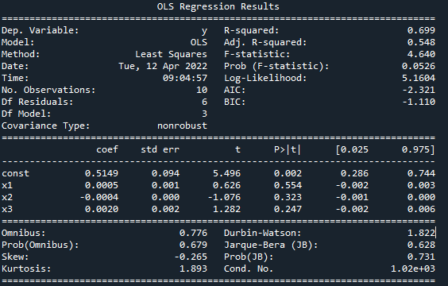
OLS Results: Literacy Dataset (literacy_rate.csv)

Slide 4
Explaining Important Parameters
Degree of freedom (df) of residuals: df = N – K
Degree of freedom (df) of model: df = K – 1
Standard Error: shows the sampling variability of these parameters
T-statistic: coef/std. error
P-value: if p < 0.05, the variable is statistically significant.
R-squared: proportion of the variation in the dependent variable that is predictable from the independent variable(s).
R-squared = 1 – [ (actual – predicted)² / (actual – mean)²]
Adjusted R-squared = 1 – [ {SSE/(n-K)} / {SST/(n-1)}]
F-statistic: goodness of fit of a regression.

Slide 5
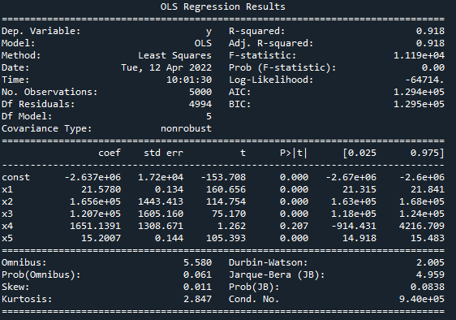
OLS Results: Housing Dataset (USA_Housing.csv)

Slide 6
Using Scikit-learn library
Preparing the dataset
Splitting the dataset into train and test data
  X_train, X_test, Y_train, Y_test = train_test_split(X, Y, test_size = 0.2, random_state = 0)
Fitting the model
  regressor = LinearRegression()
  regressor.fit(X_train, Y_train)
Evaluating the model
  Mean Absolute Error
  Mean Squared Error
  Root Mean Squared Error
  R-squared value

Slide 7
Linear Regression Model Result (literacy_rate.csv)
Intercept: [0.59560772]
Coefficients: [[ 0.00027746 -0.00028186 0.00171813]]
MAE: 0.21251505107154783
MSE: 0.056648386768940184
RMSE: 0.46099354775479
R-squared: 0.586206086421182

Slide 8
Linear Regression Model Result (USA_Housing.csv)
Intercept: [-2646630.53108713]
Coefficients: [[2.16604083e+01 1.65809651e+05 1.20329408e+05 2.19309558e+03 1.52858855e+01]]
MAE: 82657.94604670437
MSE: 10549721685.89225
RMSE: 287.50294963131137
R-squared: 0.9146454505152495

Slide 9
Lab Exercise
Write a Python script for implementing Linear Regression Model using both Statsmodel and Scikit-learn library. Your script must take the following inputs from the user
  Dataset file location/path
  Column names
  Independent variable names (predictor variables)
  Dependent variable name (response variable)
You must save the result of both OLS and Linear Regression Model in separate files.
Submit your dataset, code and result files.

